Slide 1

MVOTI TO UMZIMKULU CLASSIFICATION STUDY
PSC
Presentation and Discussion on proposed Management Classes
(Item 8.6)
26 November 2014
DWA CORPORATE IDENTITY
Presented by:
Johan Maree
Deputy Director: Media Production
12 December 2012

Slide 2
DWA CORPORATE IDENTITY
Presented by:
Johan Maree
Deputy Director: Media Production
12 December 2012
Mvoti River System
Integrated assessment and overall ranking of scenarios.
Sensitivity analysis and synthesis of results.
Derivation of the Water Resource Class for each IUA.

Slide 3
Integrated assessment and overall ranking(Score = weight x rating) of scenarios
Ecological Score : Example for EWR site 2
Node | Weights: |  | Weight Normalisation: |  |  | Scenario Rating: |  |  |  | Scenario Score:
 | Importance | Length | Importance | Length | Combined
 |  | (km) | 1 | 0 |  | 3 | 41 | 42 | 43 | 3 | 41 | 42 | 43
EWR2 | 667 | 8.3 | 0.65 | 0.01 | 0.65 | 0.78 | 1.00 | 0.96 | 0.96 | 0.51 | 0.65 | 0.63 | 0.62
27 Biophysical Nodes including 2 EWR sites
Scores summed for all nodes for each scenario then applied in integrated calculation with all four variables.

Slide 4
Variable Scores & Weights
Variables | Scenarios
 | 3 | 41 | 42 | 43
Ecological Status | 0.77 | 0.94 | 0.92 | 0.91
Ecosystem Services | 1.01 | 1.00 | 1.06 | 1.06
Economic Indicator (GDP) (R Millions) | 39 637.7 | 15 808.4 | 25 713.5 | 23 996.7
Employment | 2 1661 | 6 427 | 11 360 | 10 412
Variables | Weights
Ecological Status | 0.5
Ecosystem Services | 0.05
Economic Indicator | 0.2
Employment | 0.25
50% Ecology
50% Socio-Economic

Slide 5
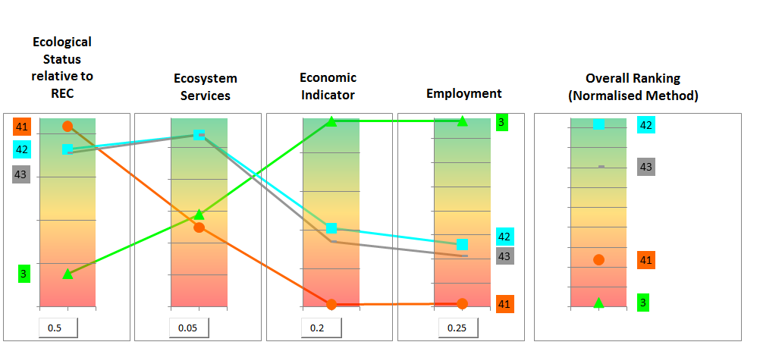
Visualisation of Variables Scores

Slide 6
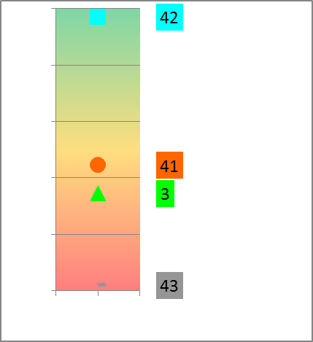
Overall Ranking (Two Rank Methods)
Method | Scenarios
 | 3 | 41 | 42 | 43
Overall Score (Rank Order method) | 2.40 | 2.50 | 3.03 | 2.06
Rank (1 = best, 4 = worse) | 3 | 2 | 1 | 4
Overall Score (Normalisation Method) | 0.457 | 0.500 | 0.636 | 0.594
Rank (1 = best, 4 = worse) | 4 | 3 | 1 | 2
Normalised
Ranking Method
Rank Order
Ranking Method

Slide 7
Sensitivity analysis and synthesis of results
Weights |  |  |  |  |  | Rank Position of Scenario (Normalisation Ranking Method)
Alternative | Ecology | EcoSystem Services | GDP | Jobs |  | 3 | 41 | 42 | 43
1 | 0.5 | 0.15 | 0.15 | 0.2 |  | 4 | 3 | 1 | 2
2 | 0.5 | 0.1 | 0.2 | 0.2 |  | 4 | 3 | 1 | 2
3 | 0.5 | 0.05 | 0.2 | 0.25 |  | 4 | 3 | 1 | 2
4 | 0.5 | 0.05 | 0.15 | 0.3 |  | 4 | 3 | 1 | 2
5 | 0.5 | 0.05 | 0.3 | 0.15 |  | 4 | 3 | 1 | 2
6 | 0.5 | 0.05 | 0.2 | 0.25 |  | 4 | 3 | 1 | 2
7 | 0.45 | 0.1 | 0.2 | 0.2 |  | 4 | 3 | 1 | 2
8 | 0.4 | 0.05 | 0.2 | 0.25 |  | 3 | 4 | 1 | 2
9 | 0.35 | 0.05 | 0.2 | 0.25 |  | 3 | 4 | 1 | 2
10 | 0.3 | 0.05 | 0.2 | 0.25 |  | 3 | 4 | 1 | 2
11 | 0.25 | 0.25 | 0.25 | 0.25 |  | 3 | 4 | 1 | 2
12 | 0.25 | 0.05 | 0.2 | 0.25 |  | 2 | 4 | 1 | 3
13 | 0.2 | 0.1 | 0.4 | 0.3 |  | 1 | 4 | 2 | 3
14 | 0.2 | 0.05 | 0.2 | 0.25 |  | 1 | 4 | 2 | 3
15 | 0.15 | 0.1 | 0.45 | 0.3 |  | 1 | 4 | 2 | 3
Rank: 1 = best, 4 = worse.

Slide 8
Mvoti River Catchment
Scenarios | Scenario Variables
 | Ultimate Development Demands & Return Flows (2040) | EWR | Isithundu Dam | Imvutshane Dam
MV1 (PD) | No | No | No | No
MV3 | Yes | No | Yes | Yes
MV41 | Yes | REC total | Yes | Yes
MV42 | Yes | REC low | Yes | Yes
MV43 | Yes | REC low+ | Yes | Yes
Discussion:
Scenario 42 is the best ranked scenarios, Scenario 43 is however close and has the benefit of total flows in January, February and March. It may be possible through operational optimisation to improve on Scenario 43.
Comments?

Slide 9
Derivation of the Water Resource Class for each IUA
Recommended Management Class Criteria Table
 |  | % EC representation at units represented by biophysical nodes in an IUA |  |  |  |  | Prominent Ecological Categories
 |  | ≥ A/B | ≥ B | ≥C | ≥ D | < D
Class I |  | 0 | 60 | 80 | 95 | 5 | A & B
Class II |  |  | 0 | 70 | 90 | 10 | C
Class III | Either |  |  | 0 | 80 | 20 | D
 | Or |  |  |  | 100
Unit Percentages:
Length of river in a given Ecological Category divided by the total river length in an IUA .
Notes:
Se hoekom ons lengte van rivier gebruik
Gee voorbeel van iets wat in 'n A is maar net 10 % van lengte is, en res van rivier is in C. Etc - as jy net 2 nodes gehad het dan is dit 50/50.
Maar nou is 90% 'n C so dit behoort klas 2 te wees.
En maak seker jy noem dat agv catchment config, beteken dit nie dat die A wegval nie.

Slide 10
Resulting IUA Management Classes for all scenarios
Integrated Unit of Analysis | Scenarios and Management Class
 | PES | REC | 3 | 41 | 42 | 43
U4-1 | II | II | II | II | II | II
U4-2 | II | I | II | II | II | II
U4-3 | II | I | III | II | II | II
U4-4 | III | II | III | III | III | III

Slide 11
Ecological Categories for all Scenarios
Nodes | River | IUA | River Length (km) | Ecological Category for Scenarios
 |  |  |  | 3 | 41 | 42 | 43
U40A-03869 | Mvoti | U4-1 | 54.5 | B/C | B/C | B/C | B/C
U40B-03708 | Intinda | U4-1 | 18.7 | C | C | C | C
U40B-03740 | Mvozana | U4-1 | 11.0 | C | C | C | C
Mv_I_EWR1 | Heinespruit | U4-1 | 27.8 | C | C | C | C
U40B-03832 | Mvozana | U4-1 | 16.7 | C/D | C/D | C/D | C/D
U40B-03896 | Mvoti | U4-1 | 9.7 | C | C | C | C
U40C-03982 | Khamanzi | U4-1 | 40.2 | B/C | B/C | B/C | B/C
U40D-03867 | Mvoti | U4-1 | 18.6 | B/C | B/C | B/C | B/C
U40D-03908 | Mtize | U4-2 | 18.9 | B | B | B | B
U40D-03957 | Mvoti | U4-2 | 27.7 | B | B | B | B
U40E-03967 | Mvoti | U4-2 | 8.4 | D | C | C | C
U40E-03985 | Mvoti | U4-2 | 27.7 | D | C | C | C
U40E-04079 | Faye | U4-2 | 21.2 | B | B | B | B
U40E-04082 | Sikoto | U4-2 | 8.0 | B | B | B | B
U40E-04137 | Sikoto | U4-2 | 23.1 | B | B | B | B
U40F-03690 | Potspruit | U4-2 | 17.3 | C | C | C | C
U40F-03694 | Hlimbitwa | U4-2 | 11.0 | C | C | C | C
U40F-03730 | Cubhu | U4-2 | 24.3 | C | C | C | C
U40F-03769 | Hlimbitwa | U4-2 | 13.3 | C | C | C | C
U40F-03790 | Nseleni | U4-2 | 5.9 | B/C | B/C | B/C | B/C
U40F-03806 | Hlimbitwa | U4-2 | 6.1 | B | B | B | B
U40G-03843 | Hlimbitwa | U4-2 | 42.5 | B | B | B | B
Mv_I_EWR2 | Mvoti | U4-3 | 8.3 | D | C | C | C
U40H-04091 | Pambela | U4-3 | 17.5 | B/C | B/C | B/C | B/C
U40H-04117 | Nsuze | U4-3 | 2.7 | B/C | B/C | B/C | B/C
U40H-04133 | Nsuze | U4-3 | 27.9 | B/C | B/C | B/C | B/C
U40J-03998 | Mvoti | U4-3 | 54.6 | D | C | C | C
Mv_Est | Mvoti_Est | U4-4 |  | E | D | D | D

Slide 12
Ecological Categories for proposed Scenarios
Nodes | River | IUA | River Length (km) | Ecological Category for Scenarios
 |  |  |  | REC | PES | 42
U40A-03869 | Mvoti | U4-1 | 54.5 | B | B/C | B/C
U40B-03708 | Intinda | U4-1 | 18.7 | C | C | C
U40B-03740 | Mvozana | U4-1 | 11.0 | C | C | C
Mv_I_EWR1 | Heinespruit | U4-1 | 27.8 | C | C | C
U40B-03832 | Mvozana | U4-1 | 16.7 | C/D | C/D | C/D
U40B-03896 | Mvoti | U4-1 | 9.7 | C | C | C
U40C-03982 | Khamanzi | U4-1 | 40.2 | B | B/C | B/C
U40D-03867 | Mvoti | U4-1 | 18.6 | B | B/C | B/C
U40D-03908 | Mtize | U4-2 | 18.9 | B | B | B
U40D-03957 | Mvoti | U4-2 | 27.7 | B | B | B
U40E-03967 | Mvoti | U4-2 | 8.4 | B/C | B/C | C
U40E-03985 | Mvoti | U4-2 | 27.7 | B | B/C | C
U40E-04079 | Faye | U4-2 | 21.2 | B | B | B
U40E-04082 | Sikoto | U4-2 | 8.0 | B | B | B
U40E-04137 | Sikoto | U4-2 | 23.1 | B | B | B
U40F-03690 | Potspruit | U4-2 | 17.3 | C | C | C
U40F-03694 | Hlimbitwa | U4-2 | 11.0 | C | C | C
U40F-03730 | Cubhu | U4-2 | 24.3 | C | C | C
U40F-03769 | Hlimbitwa | U4-2 | 13.3 | C | C | C
U40F-03790 | Nseleni | U4-2 | 5.9 | B/C | B/C | B/C
U40F-03806 | Hlimbitwa | U4-2 | 6.1 | B | B | B
U40G-03843 | Hlimbitwa | U4-2 | 42.5 | B | B | B
Mv_I_EWR2 | Mvoti | U4-3 | 8.3 | B | C | C
U40H-04091 | Pambela | U4-3 | 17.5 | B | B/C | B/C
U40H-04117 | Nsuze | U4-3 | 2.7 | B | B/C | B/C
U40H-04133 | Nsuze | U4-3 | 27.9 | B | B/C | B/C
U40J-03998 | Mvoti | U4-3 | 54.6 | B | C | C
Mv_Est | Mvoti_Est | U4-4 | - | C | D | D
Notes:
Note: * The possibilities of achieving the REC at the desktop biophysical nodes. If improvement can be achieved, the class will be adjusted to be the same as the REC.

Slide 13
DWA CORPORATE IDENTITY
Presented by:
Johan Maree
Deputy Director: Media Production
12 December 2012
uMkhomazi River System
Integrated assessment and overall ranking of scenarios.
Sensitivity analysis and synthesis of results.
Derivation of the Water Resource Class for each IUA.

Slide 14
Variable Scores & Weights
Variables | Scenarios
 | 2 | 21 | 22 | 23 | 31 | 32 | 33 | 4 | 41 | 42 | 21b
Ecological Status | 0.76 | 0.94 | 0.91 | 0.91 | 0.90 | 0.87 | 0.87 | 0.79 | 0.94 | 0.91 | 0.89
Ecosystem Services | 0.92 | 0.98 | 0.97 | 0.98 | 0.95 | 0.96 | 0.96 | 0.93 | 0.97 | 0.97 | 0.98
Economic Indicator (GDP) (R Billions) | 386.2 | 348.4 | 354.1 | 354.1 | 351.2 | 358.4 | 358.4 | 357.1 | 290.2 | 303.6 | 348.4
Employment (x1000) | 403 | 343 | 354 | 354 | 352 | 366 | 366 | 347 | 244 | 261 | 343
Variables | Weights
Ecological Status | 0.5
Ecosystem Services | 0.05
Economic Indicator | 0.2
Employment | 0.25
50% Ecology
50% Socio-Economic

Slide 15
Visualisation of Variables Scores

Slide 16
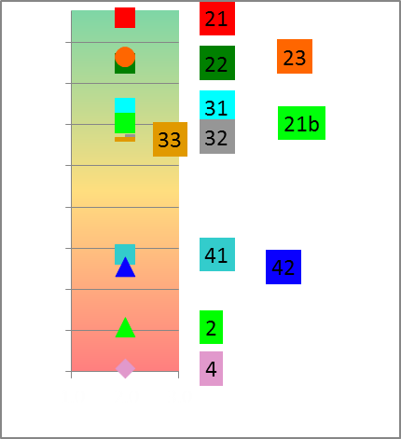
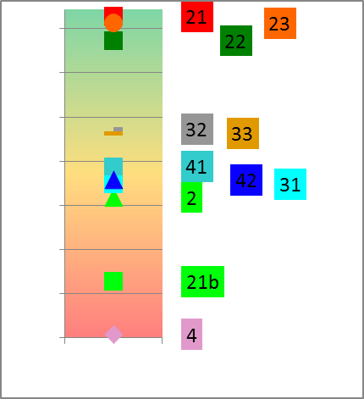
Overall Ranking (Two Rank Methods)
Method | Scenarios
 | 2 | 21 | 22 | 23 | 31 | 32 | 33 | 4 | 41 | 42 | 21b
Overall Score (Rank Order method) | 5.50 | 7.55 | 7.28 | 7.48 | 5.65 | 6.28 | 6.23 | 3.95 | 5.85 | 5.70 | 4.55
Rank (1 = best, 10 = worse) | 9 | 1 | 3 | 2 | 8 | 4 | 5 | 11 | 6 | 7 | 10
Overall Score (Normalisation Method) | 0.45 | 0.83 | 0.77 | 0.78 | 0.72 | 0.68 | 0.68 | 0.40 | 0.54 | 0.52 | 0.70
Rank (1 = best, 10 = worse) | 10 | 1 | 3 | 2 | 4 | 6 | 7 | 11 | 8 | 9 | 5
Normalised
Ranking Method
Rank Order
Ranking Method

Slide 17
Sensitivity analysis and synthesis of results
Weights |  |  |  |  |  | Rank Position of Scenario (Normalisation Ranking Method)
Alternative | Ecology | EcoSystem Services | GDP | Jobs |  | 2 | 21 | 22 | 23 | 31 | 32 | 33 | 4 | 41 | 42 | 21b
1 | 0.50 | 0.05 | 0.20 | 0.25 |  | 10 | 1 | 3 | 2 | 4 | 6 | 7 | 11 | 8 | 9 | 5
2 | 0.50 | 0.15 | 0.15 | 0.20 |  | 11 | 1 | 3 | 2 | 5 | 6 | 7 | 10 | 8 | 9 | 4
3 | 0.50 | 0.10 | 0.20 | 0.20 |  | 10 | 1 | 3 | 2 | 5 | 6 | 7 | 11 | 8 | 9 | 4
4 | 0.50 | 0.05 | 0.20 | 0.25 |  | 10 | 1 | 3 | 2 | 4 | 6 | 7 | 11 | 8 | 9 | 5
5 | 0.50 | 0.05 | 0.15 | 0.30 |  | 10 | 1 | 3 | 2 | 4 | 6 | 7 | 11 | 8 | 9 | 5
6 | 0.50 | 0.05 | 0.30 | 0.15 |  | 10 | 1 | 3 | 2 | 4 | 6 | 7 | 11 | 8 | 9 | 5
7 | 0.50 | 0.05 | 0.20 | 0.25 |  | 10 | 1 | 3 | 2 | 4 | 6 | 7 | 11 | 8 | 9 | 5
8 | 0.45 | 0.10 | 0.20 | 0.20 |  | 10 | 1 | 3 | 2 | 5 | 6 | 7 | 11 | 8 | 9 | 4
9 | 0.40 | 0.05 | 0.20 | 0.25 |  | 8 | 1 | 3 | 2 | 4 | 6 | 7 | 11 | 9 | 10 | 5
10 | 0.35 | 0.05 | 0.20 | 0.25 |  | 8 | 1 | 3 | 2 | 4 | 5 | 7 | 11 | 10 | 9 | 6
11 | 0.30 | 0.05 | 0.20 | 0.25 |  | 8 | 1 | 3 | 2 | 4 | 5 | 6 | 9 | 11 | 10 | 7
12 | 0.25 | 0.25 | 0.25 | 0.25 |  | 8 | 1 | 3 | 2 | 7 | 5 | 6 | 11 | 10 | 9 | 4
13 | 0.25 | 0.05 | 0.20 | 0.25 |  | 8 | 1 | 3 | 2 | 6 | 4 | 5 | 9 | 11 | 10 | 7
14 | 0.20 | 0.10 | 0.40 | 0.30 |  | 6 | 2 | 3 | 1 | 8 | 4 | 5 | 9 | 11 | 10 | 7
15 | 0.20 | 0.05 | 0.20 | 0.25 |  | 8 | 1 | 3 | 2 | 6 | 4 | 5 | 9 | 11 | 10 | 7
Rank: 1 = best, 11 = worse.

Slide 18
uMkhomazi River - Selection
Scenarios (MK) | Scenario Variables
 | Ultimate Development (2040) | EWR |  | Smithfield Dam | Ngwadini OCD
1 | No | No |  | No | No
2 | Yes | No |  | Yes | Yes *
21 | Yes | REC tot | (EWR 2) | Yes | Yes *
22 | Yes | REC low | (EWR 2) | Yes | Yes *
23 | Yes | REC low+ | (EWR 2) | Yes | Yes *
31 | Yes | REC tot | (EWR 3) | Yes | Yes *
32 | Yes | REC low | (EWR 3) | Yes | Yes *
33 | Yes | REC low+ | (EWR 3) | Yes | Yes *
4 | Yes | No | Yes | Yes (with support)
41 | Yes | REC tot (EWR 2) | Yes | Yes (with support)
42 | Yes | REC low (EWR 2) | Yes | Yes (with support)
Alternative wastewater management scenarios need to be evaluated (estuary).

Slide 19
Derivation of the Water Resource Class for each IUA
Recommended Management Class Criteria Table
 |  | % EC representation at units represented by biophysical nodes in an IUA |  |  |  |  | Prominent Ecological Categories
 |  | ≥ A/B | ≥ B | ≥C | ≥ D | < D
Class I |  | 0 | 60 | 80 | 95 | 5 | A & B
Class II |  |  | 0 | 70 | 90 | 10 | C
Class III | Either |  |  | 0 | 80 | 20 | D
 | Or |  |  |  | 100
Unit Percentages:
Length of river in a given Ecological Category divided by the total river length in an IUA .
Notes:
Se hoekom ons lengte van rivier gebruik
Gee voorbeel van iets wat in 'n A is maar net 10 % van lengte is, en res van rivier is in C. Etc - as jy net 2 nodes gehad het dan is dit 50/50.
Maar nou is 90% 'n C so dit behoort klas 2 te wees.
En maak seker jy noem dat agv catchment config, beteken dit nie dat die A wegval nie.

Slide 20
Resulting IUA Management Classes for all scenarios
Integrated Unit of Analysis | Scenarios and Management Class
 | PES | REC | 2 | 21 | 22 | 23 | 31 | 32 | 33 | 4 | 41 | 42 | 21b
U1-1 | I | I | I | I | I | I | I | I | I | I | I | I | I
U1-2 | II | II | III | II | II | II | II | II | II | III | II | II | II
U1-3 | II | I | II | II | II | II | II | II | II | II | II | II | II
U1-4 | II | II | III | II | III | III | II | II | II | III | II | III | II
U1-5 | II | I | III | II | II | II | III | III | III | III | II | II | III

Slide 21
Ecological Categories for top ranked scenario
Nodes | River | IUA | Ecological Category:
 |  |  | Sc 21
U10A-04115 | Lotheni | U1-1 | A/B
U10A-04202 | Nhlathimbe | U1-1 | B
U10A-04301 | Lotheni | U1-1 | B
U10B-04239 | Mkomazi | U1-1 | B
U10B-04251 | Mkomazi | U1-1 | A
U10B-04274 | Nhlangeni | U1-1 | A
U10B-04337 | Mkomazi | U1-1 | C
U10B-04343 | Mqatsheni | U1-1 | B
U10C-04347 | Mkhomazana | U1-1 | B
U10D-04199 | Nzinga | U1-1 | A
U10D-04222 | Rooidraai | U1-1 | B
U10D-04298 | Nzinga | U1-1 | B/C
U10D-04349 | Mkomazi | U1-1 | C
U10D-04434 | Mkomazi | U1-1 | C
Mk_I_EWR1 | Mkomazi | U1-2 | C
U10F-04528 | Mkomazi | U1-2 | C
U10F-04560 | Luhane | U1-2 | B/C
U10G-04388 | Elands | U1-2 | C
U10G-04405 |  | U1-2 | C
U10G-04473 | Elands | U1-2 | C
U10H-04576 | Tholeni | U1-3 | B
Nodes | River | IUA | Ecological Category:
 |  |  | Sc 21
U10H-04576 U10H-04638 | Tholeni Mkomazi | U1-3 U1-3 | B B
U10H-04666 | Ngudwini | U1-3 | B/C
U10H-04675 | Mkomazi | U1-3 | B
U10H-04708 | Ngudwini | U1-3 | B
U10H-04729 | Mzalanyoni | U1-3 | C
Mk_I_EWR2 | Mkomazi | U1-3 | B
U10J-04721 | Pateni | U1-3 | B
U10J-04807 | Mkomazi | U1-3 | B
U10J-04713 | Mkobeni | U1-4 | C
U10J-04799 | Mkomazi | U1-4 | B
U10J-04820 | Lufafa | U1-4 | B/C
U10J-04833 | Mkomazi | U1-4 | B
U10J-04837 |  | U1-4 | A/B
U10K-04838 | Mkomazi | U1-4 | C
U10K-04842 | Nhlavini | U1-4 | B
U10K-04899 | Xobho | U1-4 | C/D
U10K-04946 | Nhlavini | U1-4 | B/C
Mk_I_EWR3 | Mkomazi | U1-4 | C
MK_Est | Mkomazi_Est | U1-5 | C

Slide 22
Ecological Categories for proposed Scenarios (1 of 2)
Nodes | River | IUA | River Length (km) | Ecological Category
 |  |  |  | REC | PES | 21
U10A-04115 | Lotheni | U1-1 | 27.0 | A/B | A/B | A/B
U10A-04202 | Nhlathimbe |  | 25.7 | B | B | B
U10A-04301 | Lotheni |  | 18.9 | B | B | B
U10B-04239 | Mkomazi |  | 18.3 | A | B | B
U10B-04251 | Mkomazi |  | 8.3 | A | A | A
U10B-04274 | Nhlangeni |  | 9.7 | B | A | A
U10B-04337 | Mkomazi |  | 28.1 | B | B | C
U10B-04343 | Mqatsheni |  | 25.1 | B | B | B
U10C-04347 | Mkhomazana |  | 68.4 | B | B | B
U10D-04199 | Nzinga |  | 19.3 | A | A | A
U10D-04222 | Rooidraai |  | 13.0 | B | B | B
U10D-04298 | Nzinga |  | 27.1 | B | B/C | B/C
U10D-04349 | Mkomazi |  | 17.2 | B | B/C | C
U10D-04434 | Mkomazi |  | 1.4 | B | B/C | C
Mk_I_EWR1 | Mkomazi | U1-2 | 39.5 | C | C | C
U10F-04528 | Mkomazi |  | 20.6 | B | B/C | C
U10F-04560 | Luhane |  | 51.7 | B/C | B/C | B/C
U10G-04388 | Elands |  | 26.5 | B | C | C
U10G-04405 |  |  | 12.2 | C | C | C
U10G-04473 | Elands |  | 44.5 | B | C | C

Slide 23
Ecological Categories for proposed Scenarios (2 of 2)
Nodes | River | IUA | River Length (km) | Ecological Category
 |  |  |  | REC | PES | 21
U10H-04576 | Tholeni | U1-3 | 15.8 | B | B | B
U10H-04638 | Mkomazi |  | 15.8 | B | B | B
U10H-04666 | Ngudwini |  | 36.1 | B | B/C | B/C
U10H-04675 | Mkomazi |  | 5.1 | B | B | B
U10H-04708 | Ngudwini |  | 7.5 | B | B | B
U10H-04729 | Mzalanyoni |  | 24.4 | B | C | C
Mk_I_EWR2 | Mkomazi |  | 25.3 | B | B | B
U10J-04721 | Pateni |  | 13.8 | B | B | B
U10J-04807 | Mkomazi |  | 3.2 | B | B | B
U10J-04713 | Mkobeni | U1-4 | 24.2 | B | C | C
U10J-04799 | Mkomazi |  | 7.9 | B | C | B
U10J-04820 | Lufafa |  | 43.2 | B | B/C | B/C
U10J-04833 | Mkomazi |  | 1.3 | B | B/C | B
U10J-04837 |  |  | 4.0 | A/B | A/B | A/B
U10K-04838 | Mkomazi |  | 1.3 | B/C | B/C | C
U10K-04842 | Nhlavini |  | 26.2 | B | B | B
U10K-04899 | Xobho |  | 44.3 | C/D | C/D | C/D
U10K-04946 | Nhlavini |  | 21.8 | B/C | B/C | B/C
Mk_I_EWR3 | Mkomazi |  | 103.2 | C | C | C
MK_Est | Mkomazi_Est | U1-5 | 1000.0 | B | C | C

Slide 24
DWA CORPORATE IDENTITY
Presented by:
Johan Maree
Deputy Director: Media Production
12 December 2012
Thank You

